Slide 1


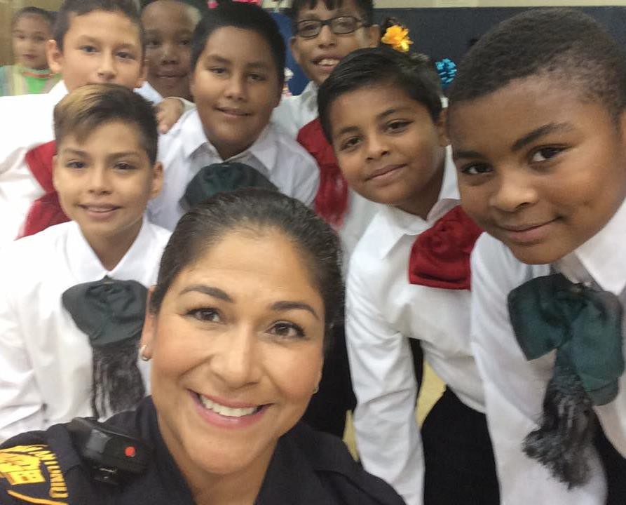


Media 101 Media Launch Take it Social
Share with Your
Community
Laura McElroy
Communication Strategist

Slide 2

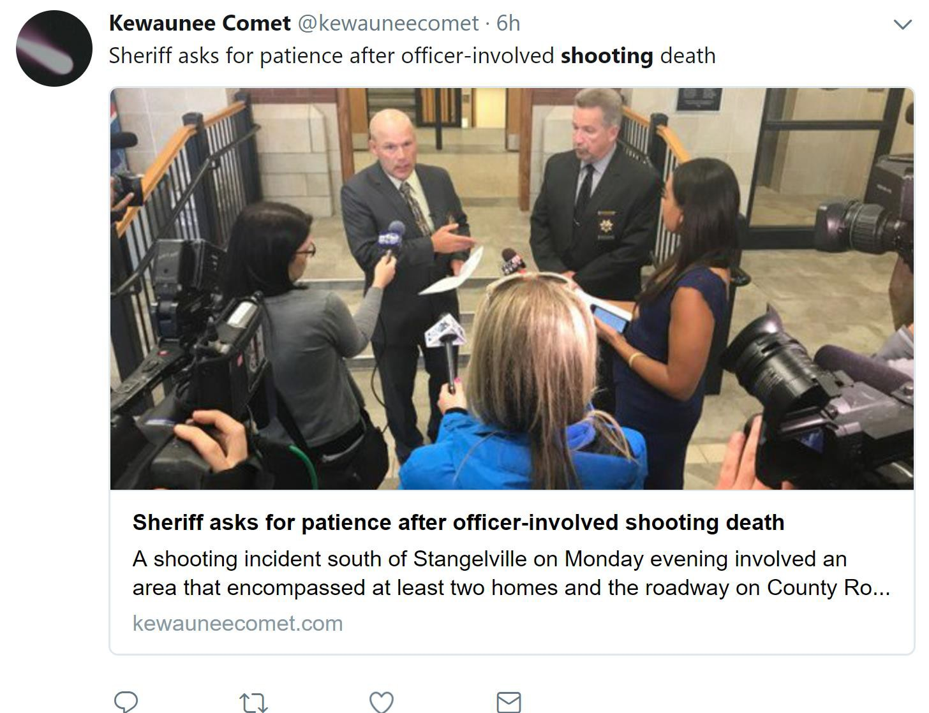

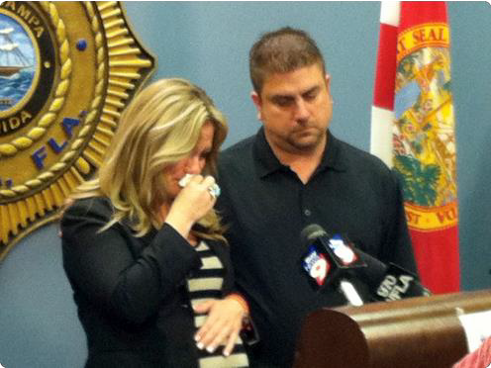

Controversy
Timing is Everything
Good Video – Even if it has Little News Value
Emotion

Slide 3


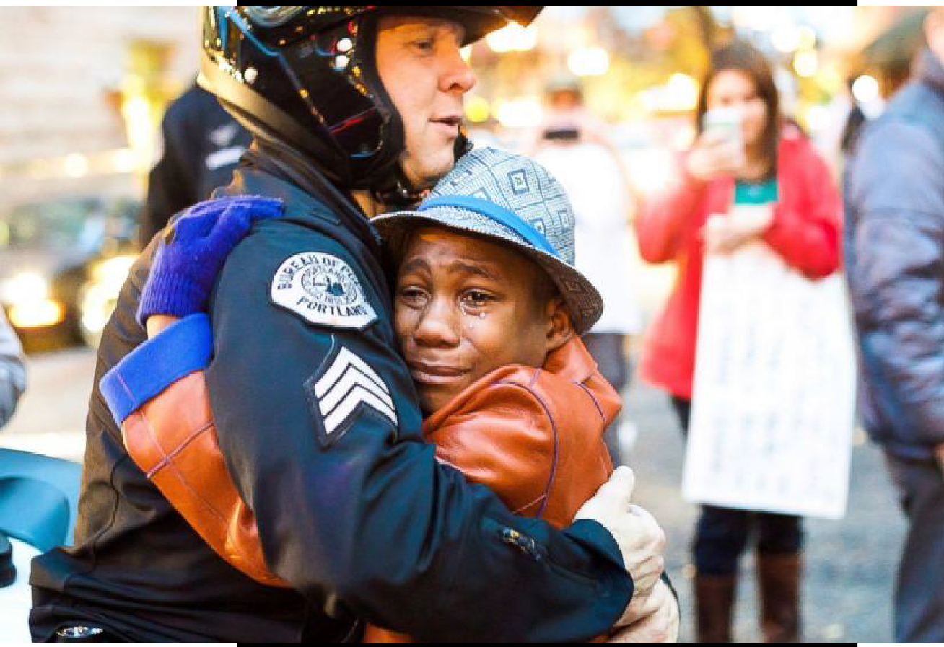
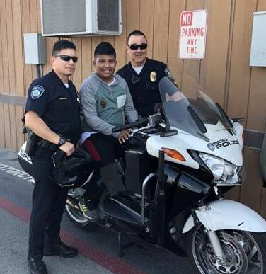


Visuals Interviews Facts
Human or Personal Element

Slide 4

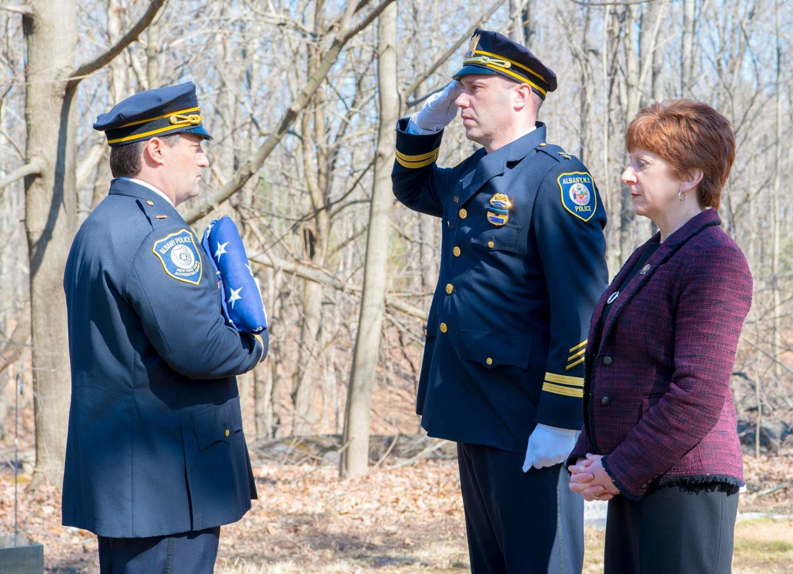
Is There a Threat to Public Safety?

Slide 5


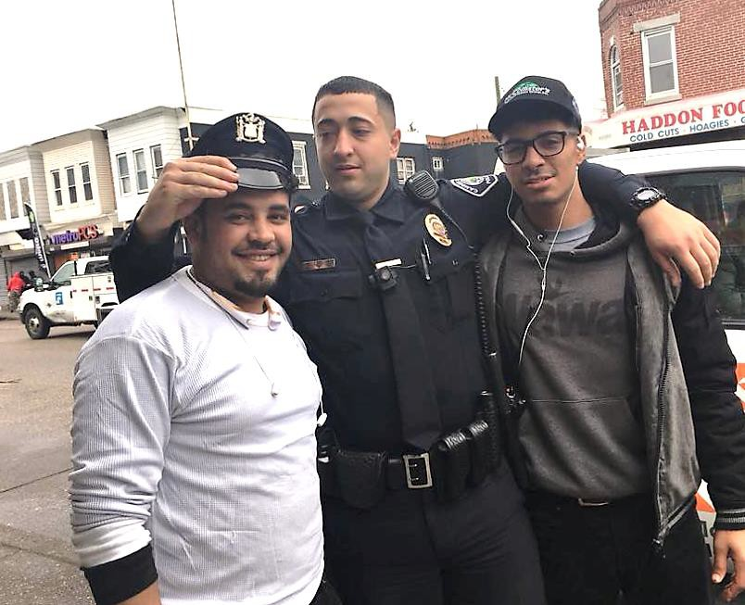
Does it Inform Citizens of How Officers are
Improving Their Safety?

Slide 6


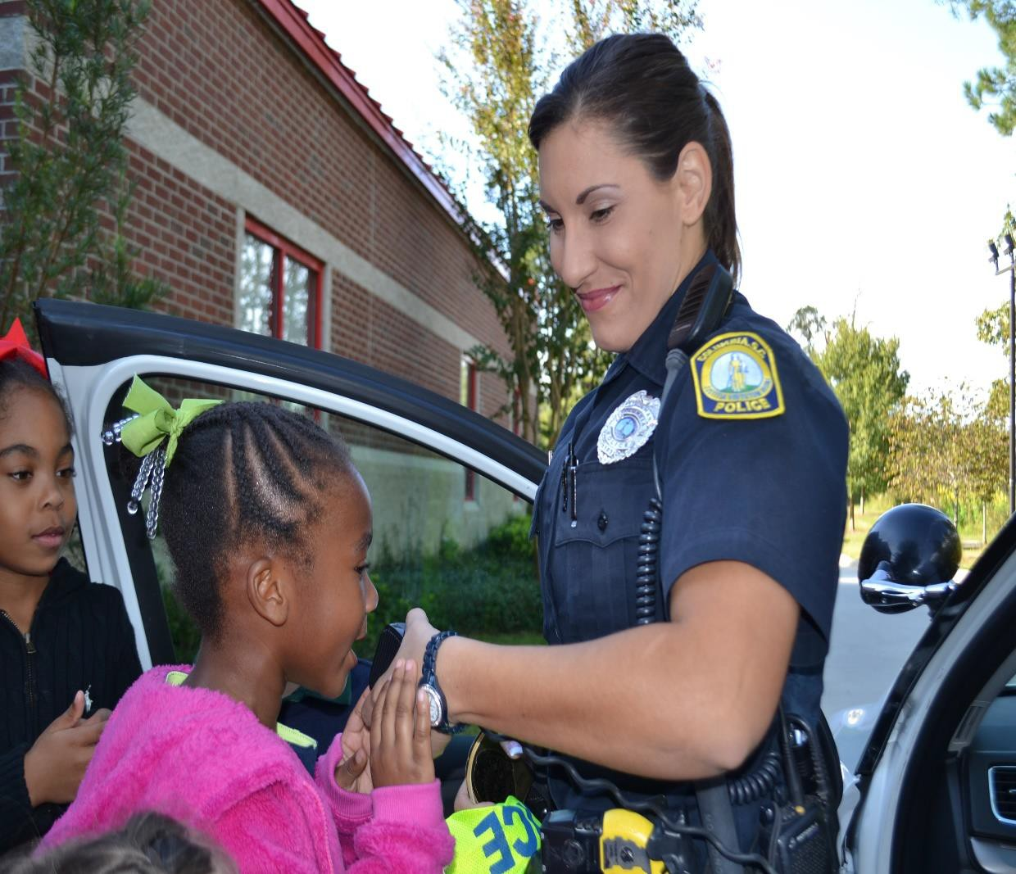
Does It Motivate Citizens to Get Involved?

Slide 7

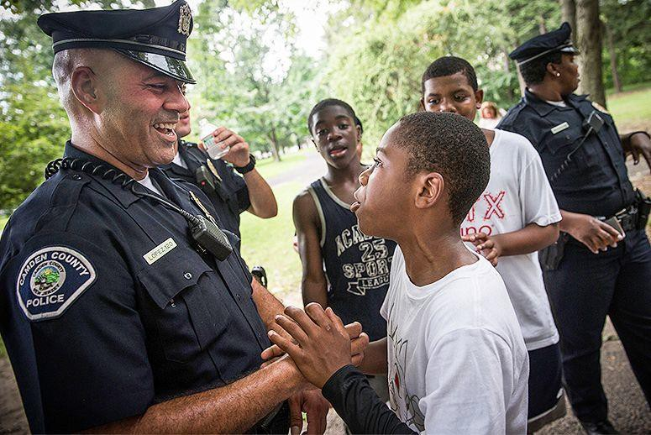


Is it News You
Can Use?
Crime
Prevention
Tips to Keep
You Safe

Slide 8

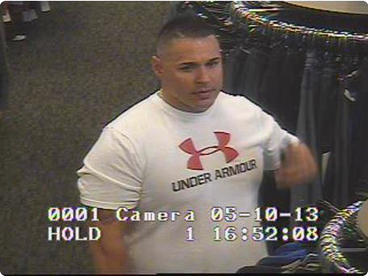
Does it Help Catch a Bad Guy?
Releasing Suspect Photo or Video

Slide 9

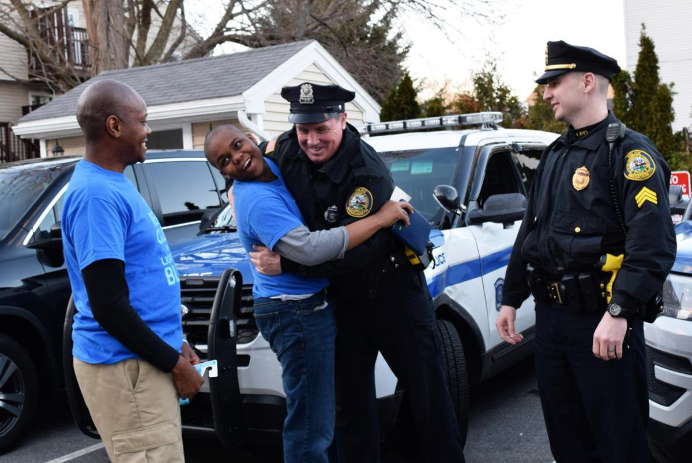
Does It Improve the Morale of Officers or Employees?

Slide 10


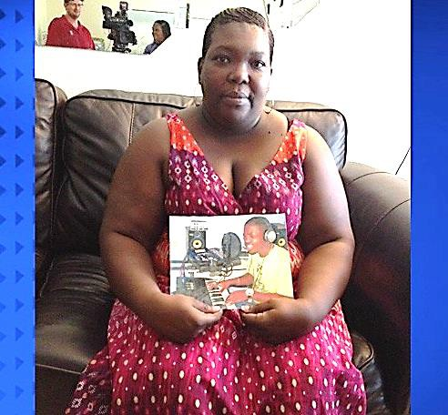

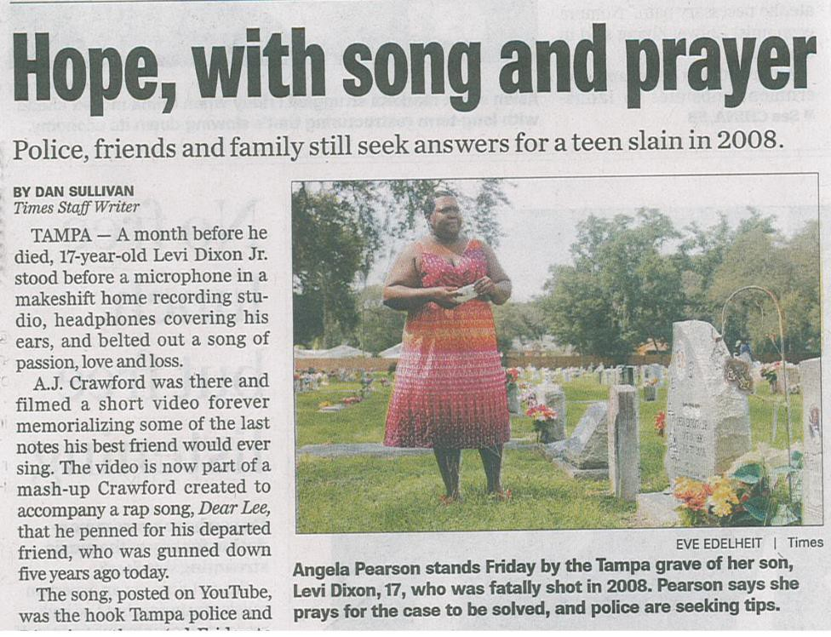
Victim’s Mother
Interviewed
Music Video with
Victim’s Friends
Location - Cemetery

Slide 11
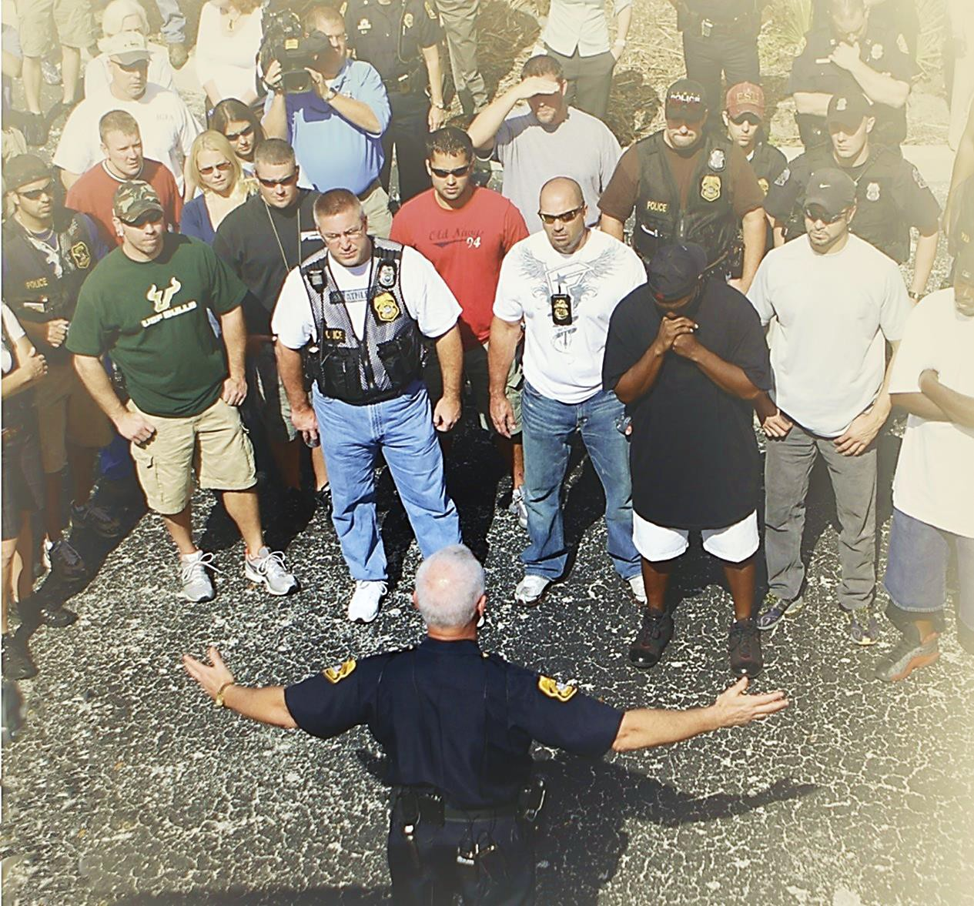
Invite Impacted Citizens & Media to Command Post
Arrests are the Visual
Element
Arrange Interviews
with Commanders

Slide 12
 Several Sexual Batteries Committed by Offenders who have Failed to Re-register
 New Law Requires Offenders to Register Twice a Year
 Sexual Battery Survivors Lobbied for the New Law
 Your Agency is Conducting Proactive Check on Predators to Ensure they are Registered
 Media is Interviewing Fearful Citizens
 How Do You Restore Sense of Safety & Refocus News Coverage?

Slide 13
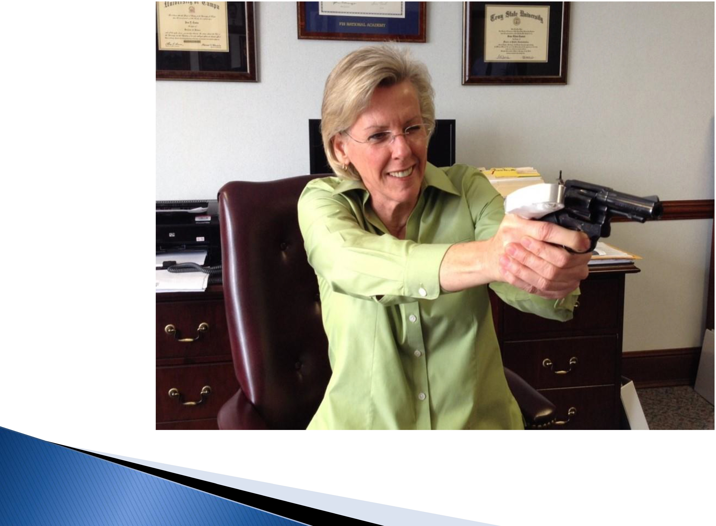

Build Story Elements to Mitigate a Negative

Slide 14
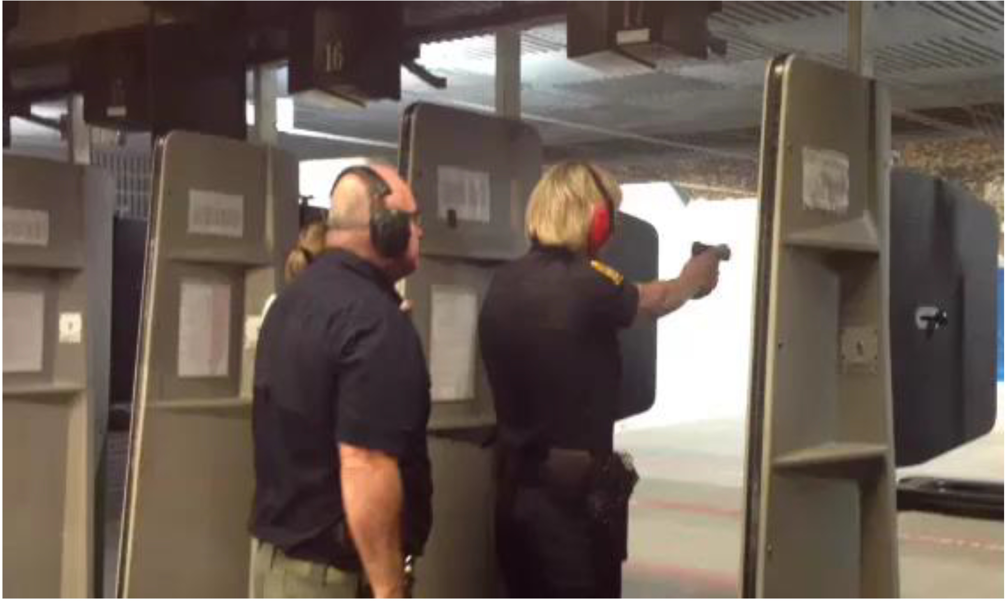


tory Elements
Build

Slide 15

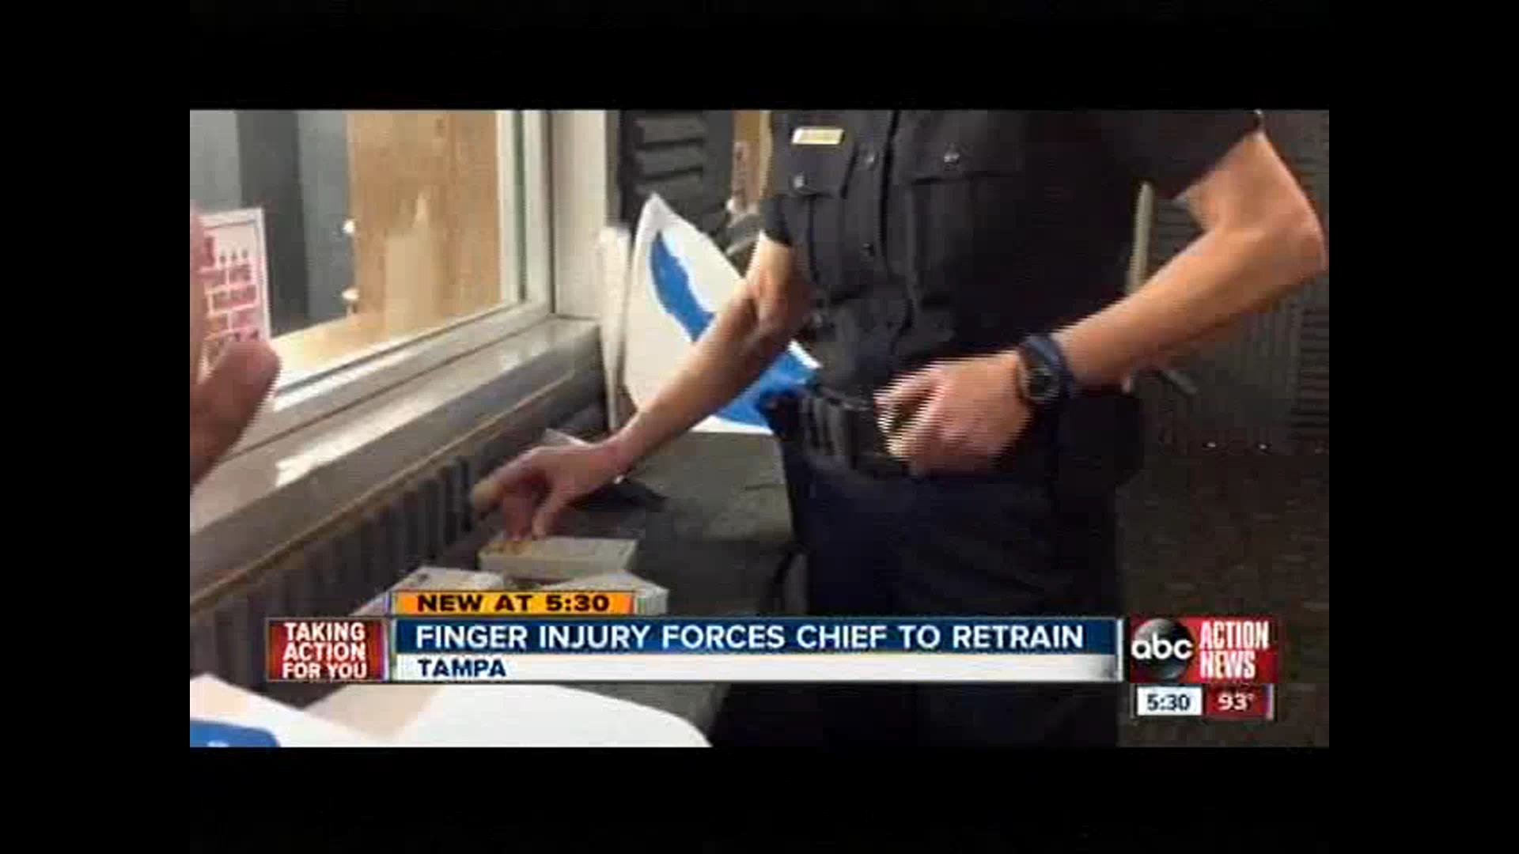

Slide 16

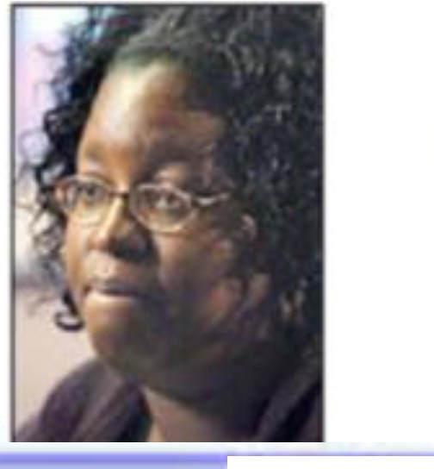


Manage Your Me ag
 | Hostage prayed, pleaded Sandra Soley got five children out of harm's way. Then she kept her captor talking and calm. She didn't even know she was shot until after escaping . By KEVIN GRAHAM Published February 4, 2005 TAMPA • Sandra Soley remembers hearing police sirens, t en seelng a white car heading In her direction. Soley was loading a car to leave the Tampa Festoval centre shopping plaza when the man driving the stolen O,rysler LeBaron Ju m ped out, ran toward her and Jammed a .38 -cal ber pistol to her ned<. "Give me the keysl l need the keysl " he demanded. ·My frie,\tt In th,a. ctrv'P h <. th,.. ltPV< • tnll1 him lnnltlnn fnv\rN"Mlv » th11- | Local law enforcement only knew that a s spect from a Jad<sonvlKe homicide, possibly rrom a drug deal gone bed, was traveling In the area, Mcelroy said. Officers saw the car on Nebraska Avenue and followed him, she said. The man steered Into the pandng lot or the shopping mall. Miles' gfrtfrlend, Kimberly Hut chinson, 34 , jumped out of the c.ar and ran Into the woods. Police later caught her. A Tampa couple In the bade seat, Tlmothy Deese, 25, and Michelle Hutcnlns, 21, were a lso later taken Into custody. !here were rour people in the car, and they al got out and ran in different directlOf"ls,· Mcelroy said. " We dldn1 know who any or those four people were . We believed there was the possibility or a murder suspect In that group. It was a very diaotJc scene. It would have been very dangerous to shoot, and it woukt have been a violation dour policy to shoor with out knowing the .s.tuation."' McElroy said the shooting is still under 1nv est1gat,on, and it has not yet been determ,ned if police knew Miles had a gun when he Jum ped out or the car, because It was dark outside. " We appeared to be making progress (with negotiations) ror two hours and 15 minutes; cflroy said. " I t aM ren apart very, very qulddy." Soley left the hosp[tal Thursday with bandages aaoss the fresh wounds on her cnest. She said a Dollce sha'1lshooter's bullet likely entered from her rlQht side, orazJno her cnest and leaving a
 | ^{five you} Tampa Ho age Is: back ... "!fl dor Without •Get OU1 ^{them tc} 'In Good p1r1t ' Bobbie I she "'He cou what co Instead, LeSabre ^{ey} For the .... , _ .. _
 | Tampa police SWAT snipers ftred three shots Tuesday night, hitting Miles twice In the head and grazing Soley with a third bullet In the cnest and arm. "He had the gun po,nted to my stomach the whole time,· Soley said Thursday, moments after being released from Tampa General Hospital. TWo days alter the standofr, Soley said she wonders why police didn't act sooner, shooting Miles before he had a cnance take her hostage. " It dldn\ have to go this far; she said. "I th ink they could have stopped this guy before he got to where other people were." Soley said police could have set up a road block or even shot Miles In the leg when they saw him get out or his car with a gun. PoUce spokeswoma,n Laura McEln>y said It wasn't that simple. " We only use deacly force as an absolutely last resort." McElroy said. " Wh en we were following the vehkie, we cldn't have any confirmat ion of who was In the vehide .· | Soley did what she could to calm the agitated Miles. They excnanged names, and she ma intained eye c:ontaa. with him every time he spoke to her, she said. Soley said Miles told her he used crack axa lne, and he'd k1Ked two people in )acksonv1lle . "If he lolled two people, I knew he moght k1N me ; she said. " I Just kept telhng him, "I got two klds. I got two luds. They're watcning me.·· Miles told police he wanted to spe k with Hut cnlnson. He also wanted a cigarette and something to drink. "He was like, "Hurry upl l need a dgarene. I'm nervous;• Soley said. At ftrst, police gave him one ogaren e, already lit, Soley said. Then, they offered M,les a pack or Manboro Lights, with Just a rew ogarenes left, and two bottles or COca-Olla ror both or them . "I might as well smoke one, too, w h you; Soley told him, even though she doesn't smoke. She took 11es· ht cigarette to light her own. As the two got down to their last drag, she reah.zed

Slide 17
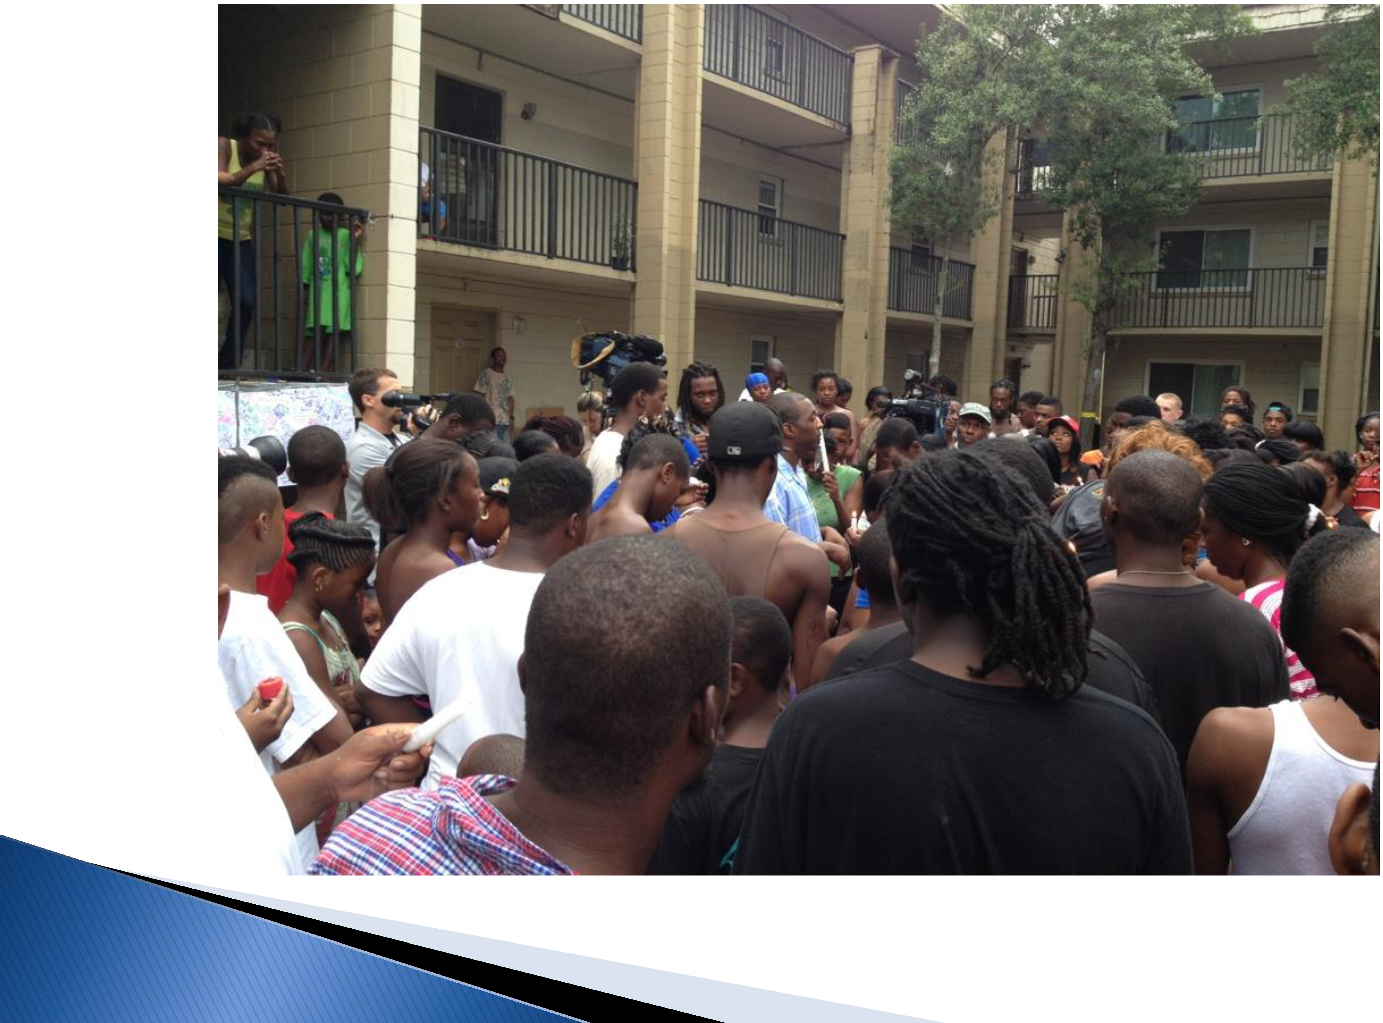
Manage the Message

Slide 18
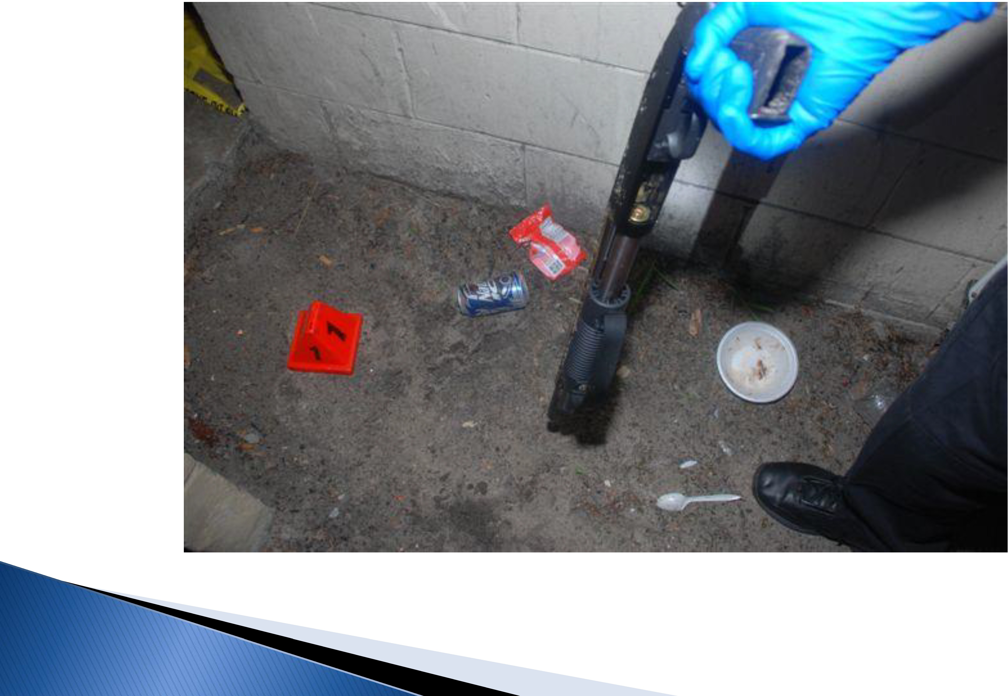
Manage Your Mes age

Slide 19
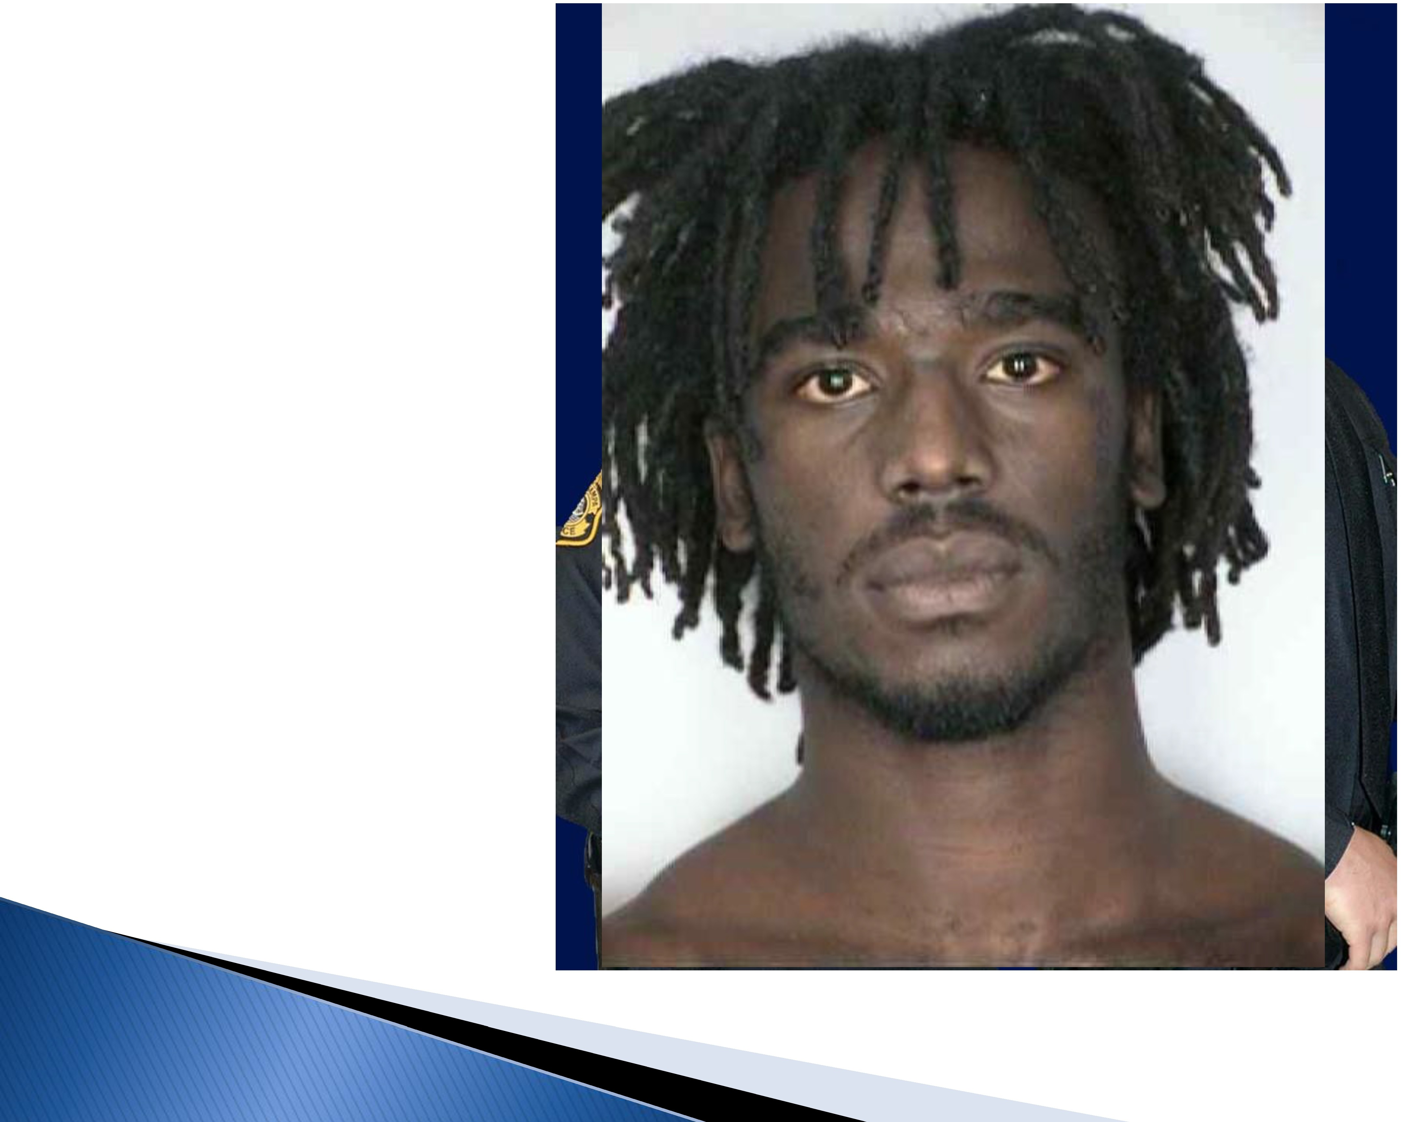
Activity
Building
upport for Polic

Slide 20

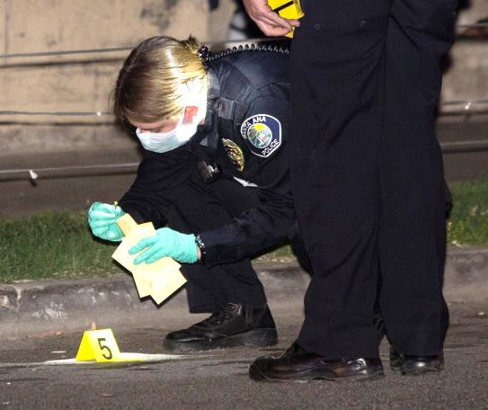
Elements that Make a Story Less News Worthy
Share with PIO
Shooting Victim and Suspects have Extensive Criminal Records
Gang Members
Domestic
“We Believe the Victim was Targeted”

Slide 21
 Your Department is Making Progress Reducing Crime, but
the Media is Calling about Several Recent Homicides.
 You Launched a New Crime Fighting Technology One Year
Ago
 Your Officers have had Success Quickly Solving a Few
Cases in the Same Area as the Recent Homicides.
 You Shared the Details with Citizen Activists and They
were Impressed.
 Detectives have Build a Strong Rapport with the Victims’
Family Members which have Helped the Cases.
 What Steps Can You Take to Redirect the News Story?

Slide 22
wift Action to Manage the Mes age
1 Paradegoer
0 U_R_ Q P I N I O N
Outrageous Gasparilla Arrest
Reports Rape, Jailed On Warrant
ADVOCATE FEARS 'A CHILLING EFFECT'
Ry VALEJIIE KAI FRIN
The Thmpa ll'ibuoc
. TAMPA A 21-year-old woman told police Saturday that a man grabbed her off Howard Avenue and raped her behind a building during the Gasparilla festivities.
But officers investigating the case arrested her after learning she had an outstanding warrant from he teenage years for failure to pay restitution.
Sh spent the next two nights in jail.
Pohce are reviewing their policies after the arrest which one victim's advocate said could have · chilling, effect" o_n the rape investigation, the woman s well-bcmg and the desire of future victims to contact police.
;he :,-,o an's family is outragt.'<I.
We re mcensed. Everyone is just beside them­ selves," her mother, 47, said at 5:20 p.m. Monday, moments before escorting her daughter from Ori­ ent Road Jail.
The Tampa_ Tribune is not identifying the wom­ an or her family because police are investigating a sex cnme.
"You've got to make sure you throw somebody in jail on a four-year-old felony warrant after they've
Prompts Quick Policy Change
T he jailing of a woman who told police she had been raped during Gasparilla
for serious violent felonies would not be given the same consideration, which makes sen e.
Since 2002, police officers have not
routinely arrested victims of violent crime on outstanding misdemeanor war­ rants because the department does not want to further traumatize victims of
vio lent crimes. Now the policy will be extended to nonviole nt felonies.
In this case the victim was wanted on a
four-year-old warrant for having failed to pay restitution in an auto theft and bur­ glary case. The woman says she thought the matter had been resolved.
Nevertheless, she was jailed. Then, to make matters worse, she claims to have
been refused a second dose of emergen­ cy contraception prescribed by a nurse at a clinic as part of a rape examination.
The mother of the girl said the nurse at the jail, who works for a private contrac­ tor, denied the dose because of religious convictions.
The Hillsborough Sheriffs Office should investigate the woman's claims. If they turn out to be true, the contractor should be called to account. Rape victims
- even when jailed - should be given the
treatment they need.
The episode gave Tampa police a black eye. But at least Hogue respo nded quick­ ly. The corrected policy shou ld minimize the chances of a reoccurrence. Still, there
merited the outraged headlines and t:ondemnation directed toward the Tam­ pa Police Department.
The police enforced a policy that re­ quired the arrest of victims sought on felony warrants. But whatever the policy
for treating victims wanted on previous charges, the arresting officers should have understood that putting a trauma­ tized woman behind bars for two days was insensitive, if not abusive.
1low is throwing a rape victim in jail
protecting and serving the community? The reports of what happened to the victim would discourage any woman with a criminal past from reporting a exual assault.
Fortunately, Police Chief Steve I logue ordered a change of policy yesterday, giving shift commanders more discretion
µi handling these sensitive cases. Officers
are capable of balancing compassion and duty and should have the authority to do so.
Indeed, police officers use discretion
every day in everything that they do. 'fhat's the nature of their work.
Under the new policy, victims of seri­
ous crimes wanted for a traffic, misde­
\neanor or fe lony property crime will not
be arrested. Nor will distraught family
membe_rs who 1!1a lose their tempers.

Slide 23
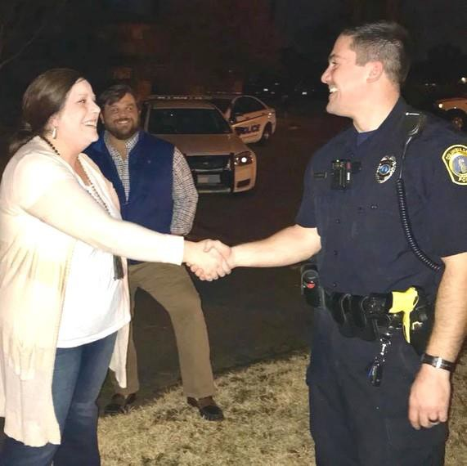
Productive Partnerships
Bigs In Blue
Front Porch Roll Calls
24/7 Public Information System

Slide 24
Productive Partnerships
Bigs In Blue
Front Porch Roll Calls
24/7 Public Information System

